Slide 1
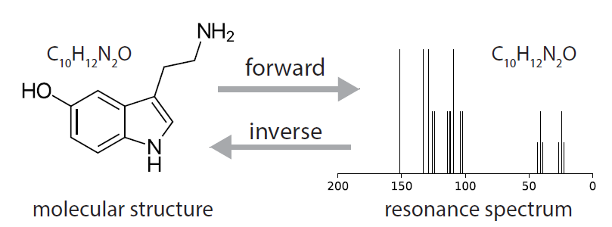
Deep imitation learning for molecular inverse problems
Kirk Swanson

Slide 2
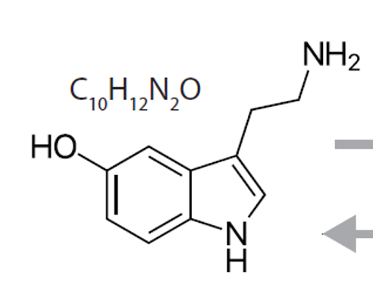
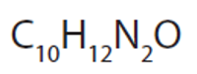
Motivation: determining molecular structure
?

Slide 3
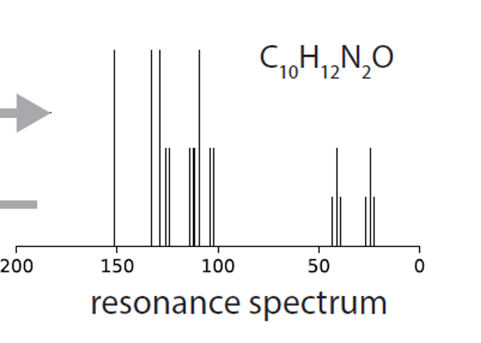
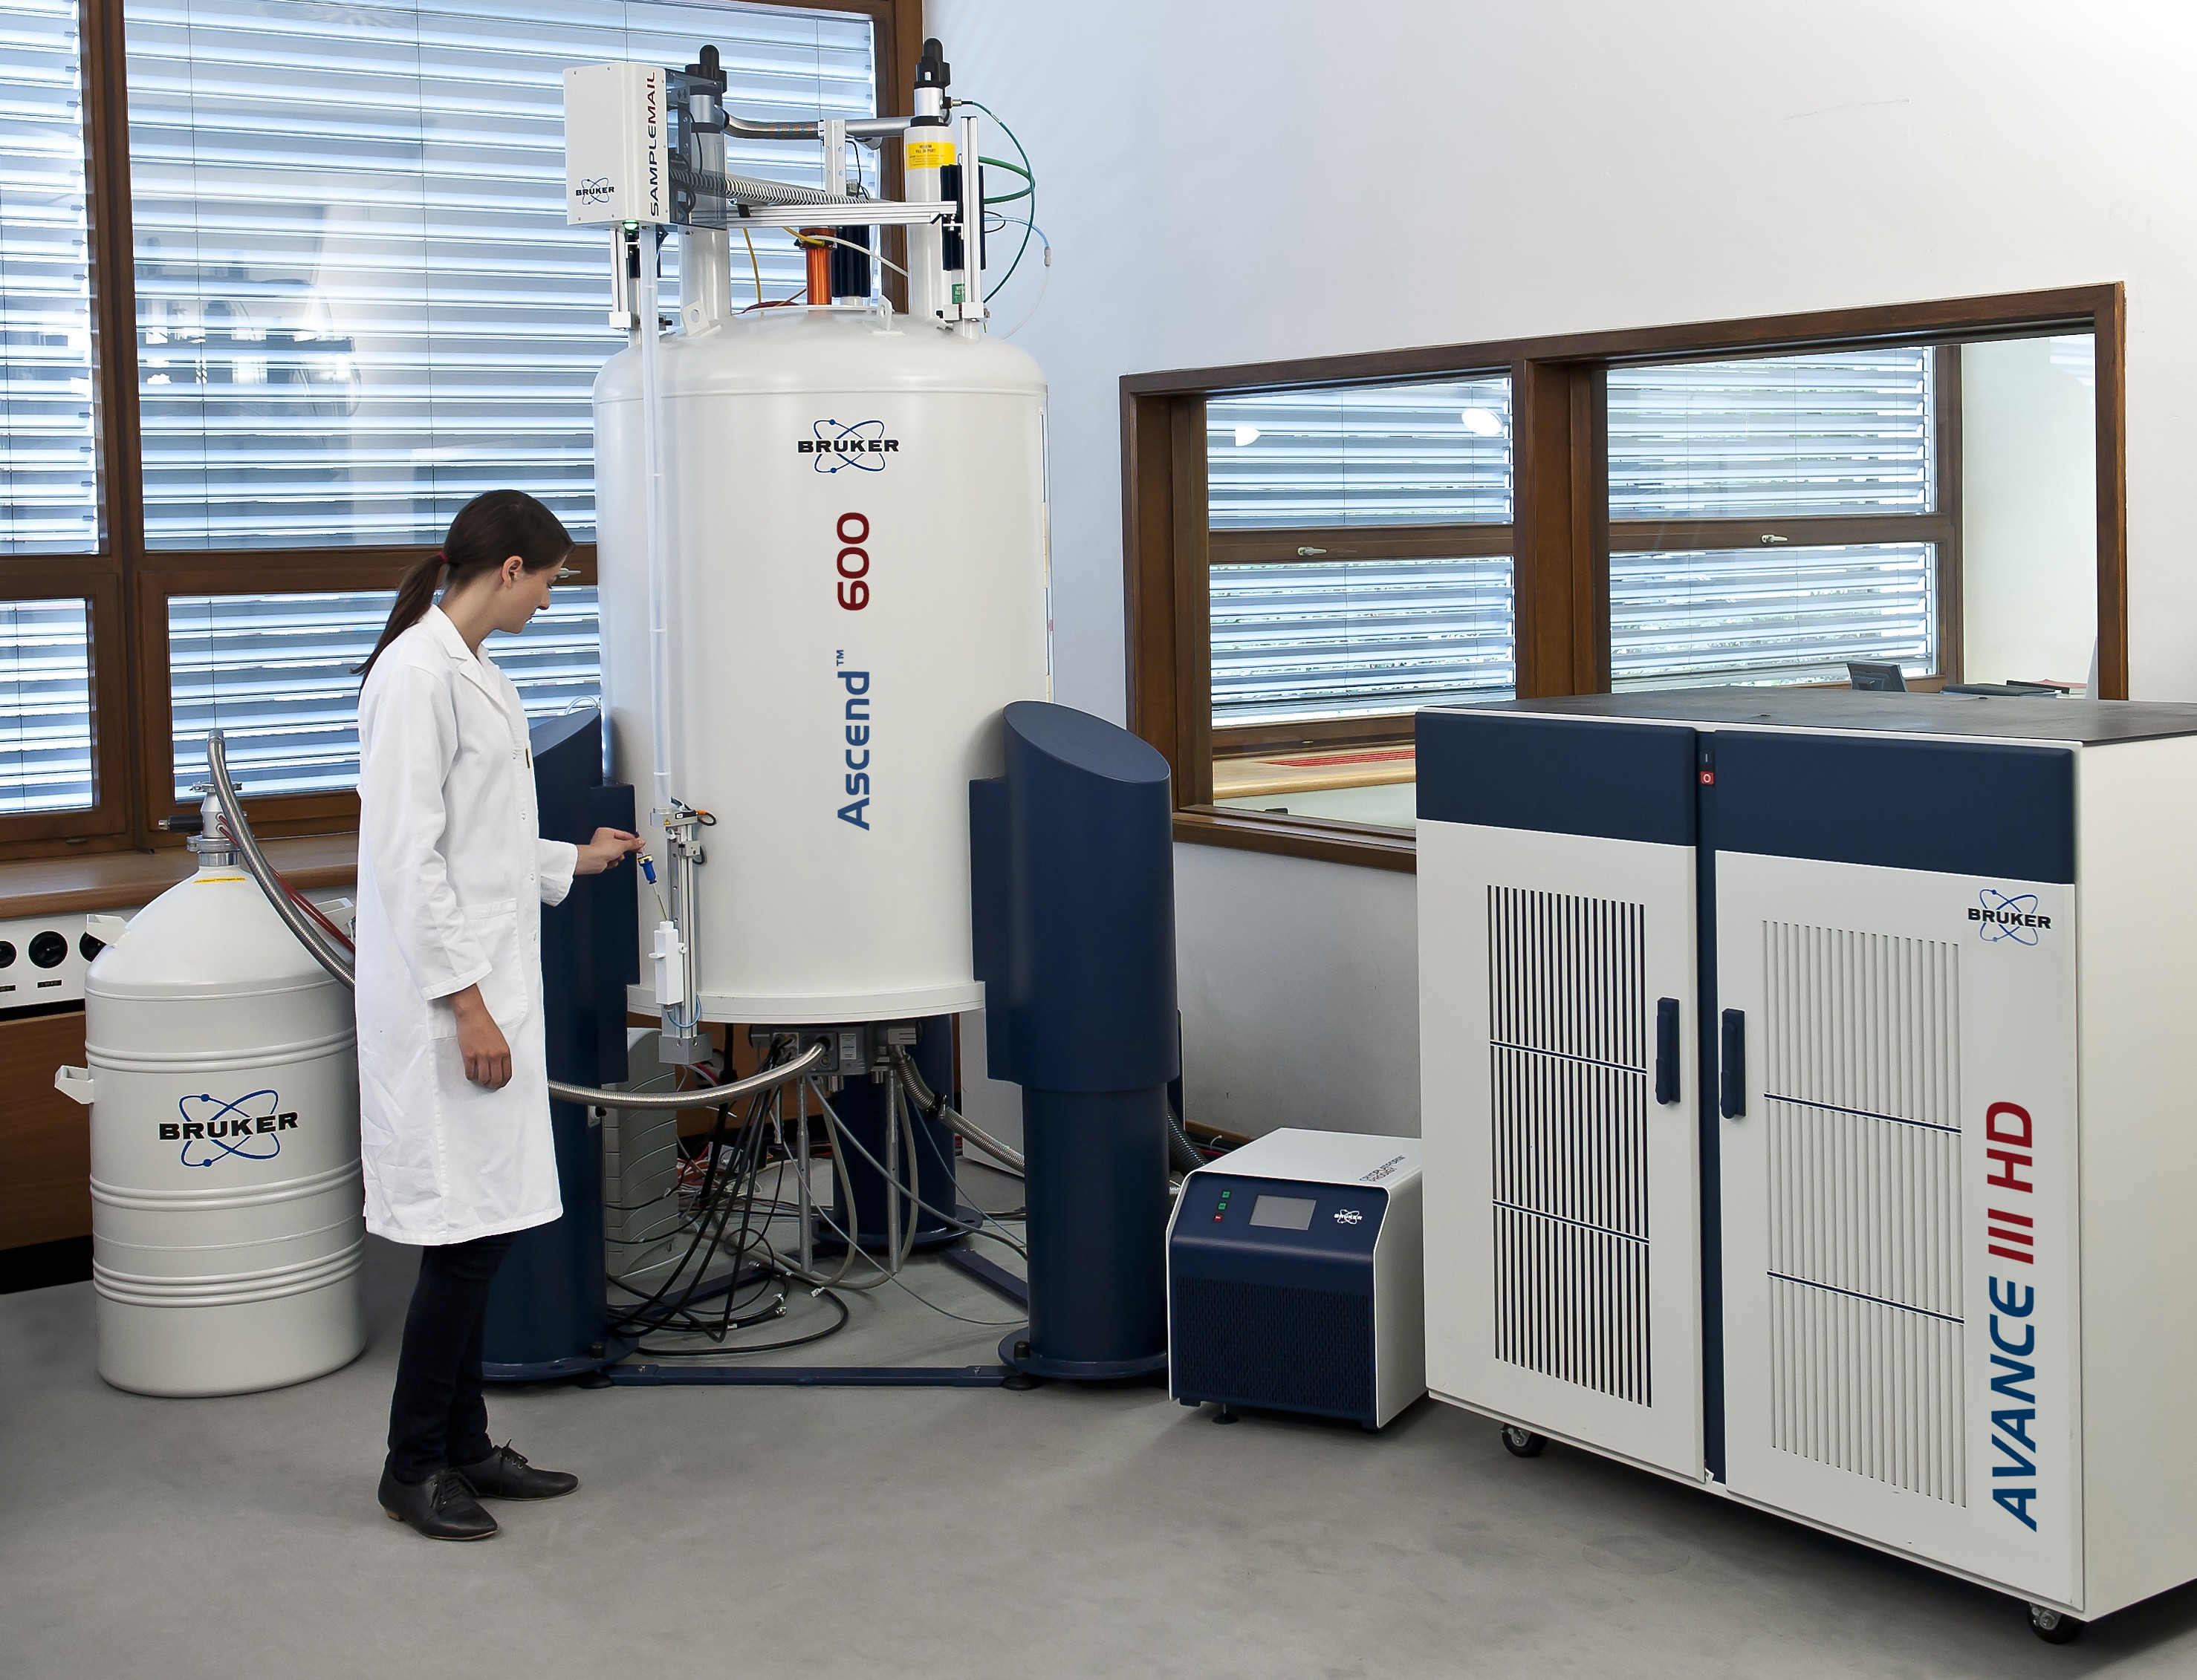
One method is NMR spectroscopy

Slide 4
One method is NMR spectroscopy

Slide 5
One method is NMR spectroscopy

Slide 6
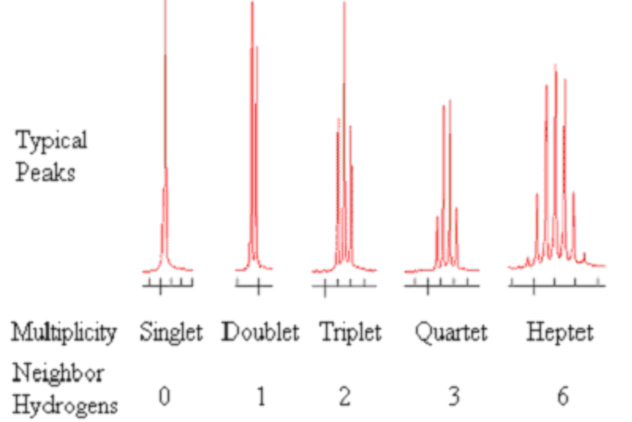
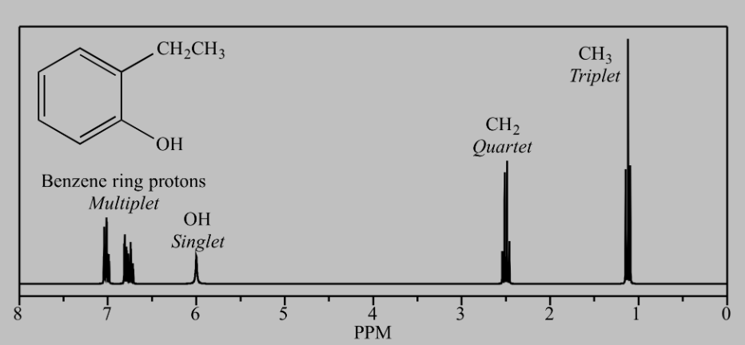
Resonance spectrum yields structural information
The main properties measured are chemical shift and peak splitting
Spectral properties are measured for a subset of atoms
This paper focuses on Carbon-13 NMR

Slide 7
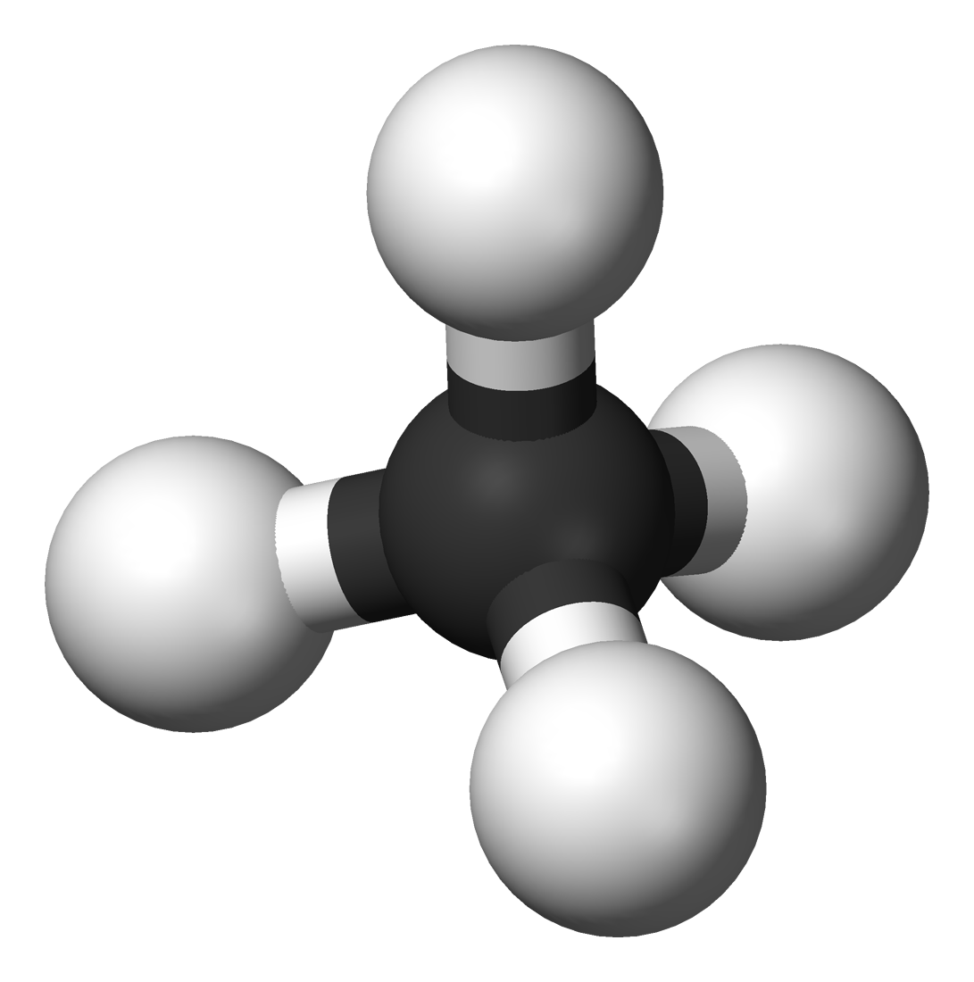
Graph representation of molecules
H
V₂
c = 1
V₅
H
c = 1
C
c = 1
H
V₃
V₁
c = 1
V₄
H
methane
Nodes V have a color (element), valence (maximum degree)
Edges E have a label corresponding to bond type (1, 1.5, 2, or 3)
Molecule G = (V, E) simple, connected, and obeys color-degree relationship

Slide 8
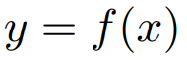
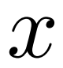
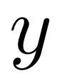
NMR spectroscopy as an inverse problem on graphs
Inverse problem: invert a known forward model to make inferences about the unobserved from measurements
Given a collection of per-atom (vertex) measurements, can we recover the molecular structure (labelled edges)?

Slide 9
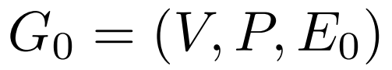
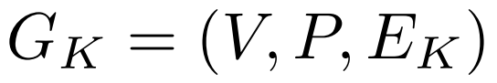
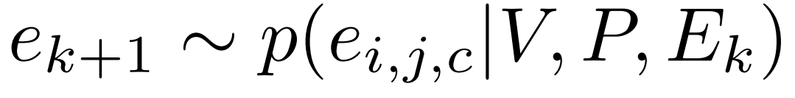
Markov decision process
Start with a known set of vertices V and their observed properties P
Formulate this as a Markov decision process by sequentially add bonds until the molecule is connected and all per-vertex constraints are met:
Add bonds by sequentially sampling from
start graph on 0 edges
Finished graph on K edges

Slide 10
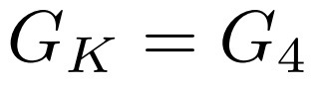
Markov decision process
H
H
C
H
H

Slide 11
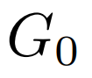
Markov decision process
P₂
P₅
P₁
P₃
P₄

Slide 12
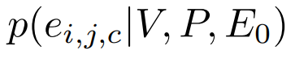
Markov decision process
P₂
0.1
0.05
0.1
0.2
P₅
0.1
P₁
P₃
0.2
0.1
0.05
0.05
0.05
P₄

Slide 13
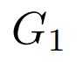
Markov decision process
P₂
P₅
P₁
P₃
P₄

Slide 14
Markov decision process
P₂
P₅
P₁
P₃
Connected + per-vertex constraints met?
P₄

Slide 15
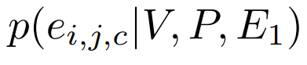
Markov decision process
P₂
0.05
0.1
0.1
0.3
P₅
0.2
P₁
P₃
0.0
0.1
0.05
0.05
0.05
P₄

Slide 16
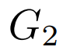
Markov decision process
P₂
P₅
P₁
P₃
P₄

Slide 17
Markov decision process
P₂
P₅
P₁
P₃
Connected + per-vertex constraints met?
P₄

Slide 18
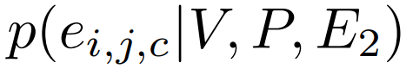
Markov decision process
P₂
0.05
0.1
0.1
0.0
P₅
0.3
P₁
P₃
0.0
0.2
0.05
0.05
0.05
P₄

Slide 19
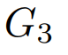
Markov decision process
P₂
P₅
P₁
P₃
P₄

Slide 20
Markov decision process
P₂
P₅
P₁
P₃
Connected + per-vertex constraints met?
P₄

Slide 21
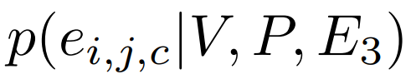
Markov decision process
P₂
0.0
0.1
0.1
0.0
P₅
0.0
P₁
P₃
0.0
0.8
0.0
0.0
0.0
P₄

Slide 22
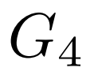
Markov decision process
P₂
P₅
P₁
P₃
P₄

Slide 23
Markov decision process
P₂
P₅
P₁
P₃
Connected + per-vertex constraints met?
P₄

Slide 24
Markov decision process
H
Isomorphic to original graph?
H
C
H
H

Slide 25
Markov decision process
How to we learn a probability distribution over next possible edges?

Slide 26
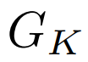
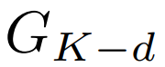
Imitation learning
We do this by constructing training examples as follows:
1. Delete a random number of edges, d, from a molecule
H
H
H
C
H
H
C
H
H
H

Slide 27
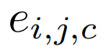
Imitation learning
We do this by constructing training examples as follows:
2. Compute which edges we can add to the partially completed graph ,
such that is subisomorphic to :
H
0
1
0
0
H
0
C
H
1
0
0
0
H

Slide 28
Imitation learning
Training data point:
P₂
V₁
V₂
V₃
V₄
V₅
V₁
0 1 1 0 0
1 0 0 0 0
1 0 0 0 0
0 0 0 0 0
0 0 0 0 0
P₅
P₁
P₃
V₂
V₃
V₄
V₅
P₄
input
target

Slide 29
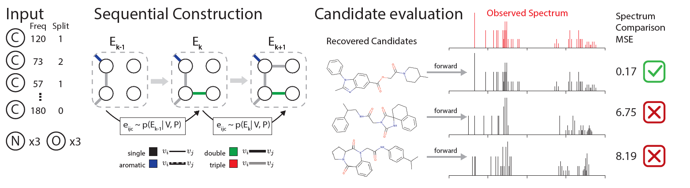
Imitation learning
Evaluate multiple candidate structures

Slide 30
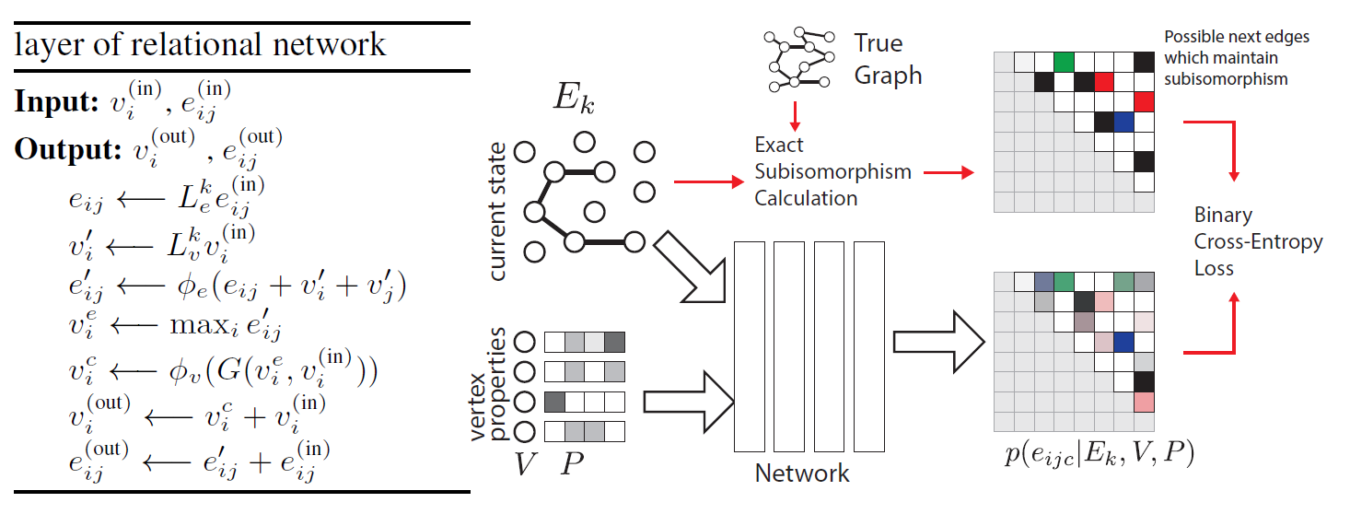
Model architecture: relational network
Combine edge and vertex info
Aggregate
Skip connections

Slide 31
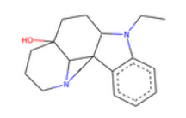
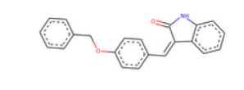
Dataset
Use a forward model, previously trained on experimental data, to compute NMR spectra for molecular structures containing H, C, O, and N atoms
Total of 1,268,461 total molecules, about 65% used for training

Slide 32
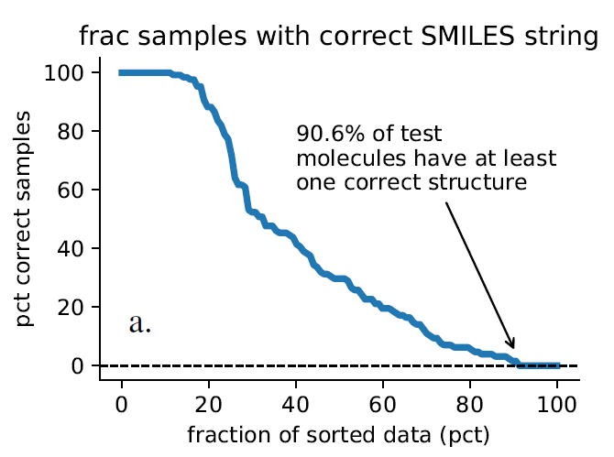
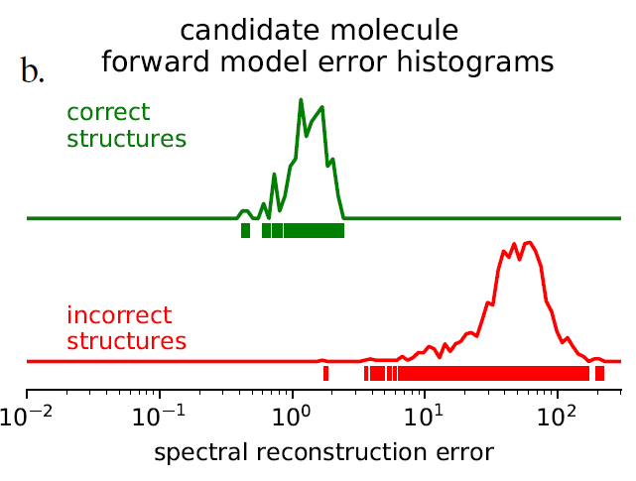
Evaluation on noiseless synthetic data
Is the combination of chemical shift and peak splitting data sufficient to recover correct molecular structure?
Generate 128 generated candidate structures for each NMR spectrum
Compare SMILES strings to check molecular equivalence

Slide 33
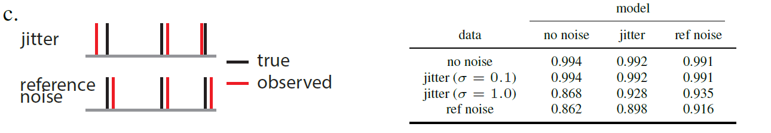
Evaluation on noisy synthetic data
Inverse problems can be ill-posed in the sense that the solution can vary wildly with slight perturbations of the input. Is this problem ill-posed?
Select best candidate below a reconstruction error threshold
Vary the threshold to compute AUC

Slide 34
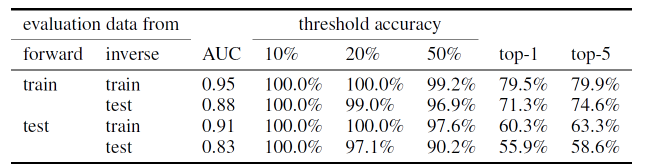
Evaluation on experimental data
The inverse model was never trained directly on experimental data. How does it perform?
Highlighted result: when reconstruction error threshold selects the 50% best molecule candidates, recover correct structure 90.2% of the time
Drop in AUC from train to test for both forward and inverse suggests they are both important for accuracy, so improvements in either model are important

Slide 35
Challenges and questions
There is a lack of experimental data, especially 2D NMR data. Will this hinder extension to larger molecules?
“One challenge is that the accuracy of chemical shift prediction for NMR spectra is less accurate for other elements such as S, P, F, and Cl.” Is this a barrier to extending to different types of molecules?
Molecules with free radicals and large rings were removed from the dataset. Is there a way to address these types of molecules?
Would simulating proton (H) NMR spectra with a forward model be difficult?
Any ideas on incorporating explicit geometry into the model?

Slide 36
Implementation toy problem
2
forward
2
2
inverse
2
2
2

Slide 37
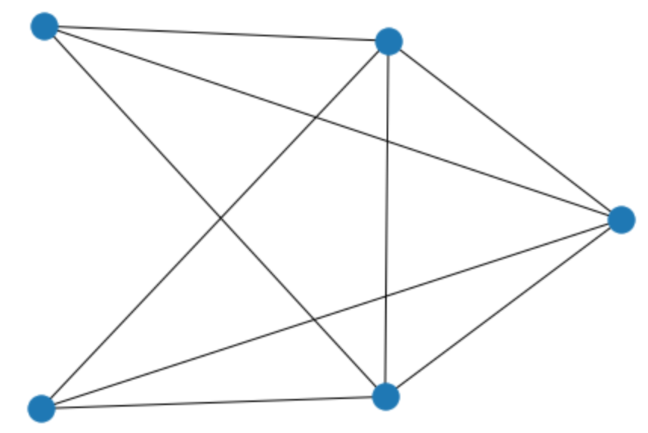
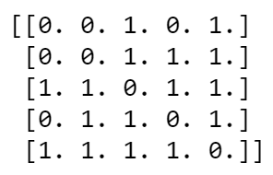
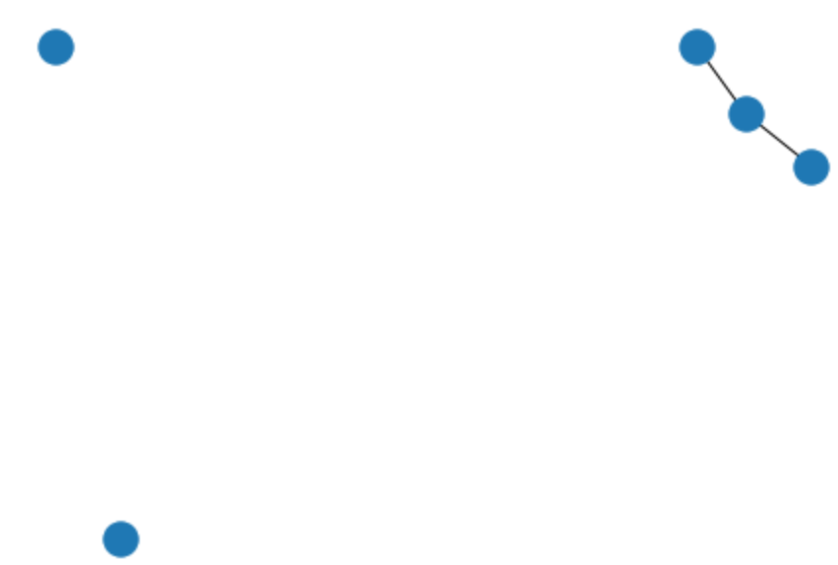
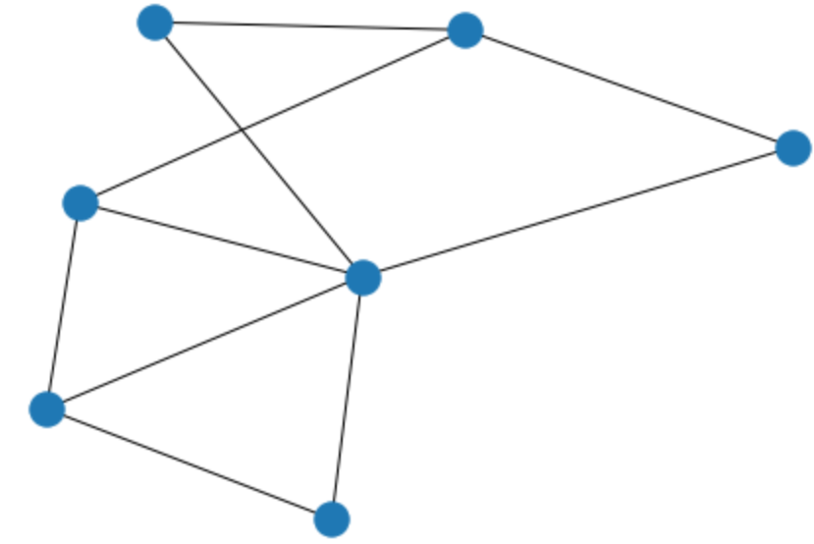
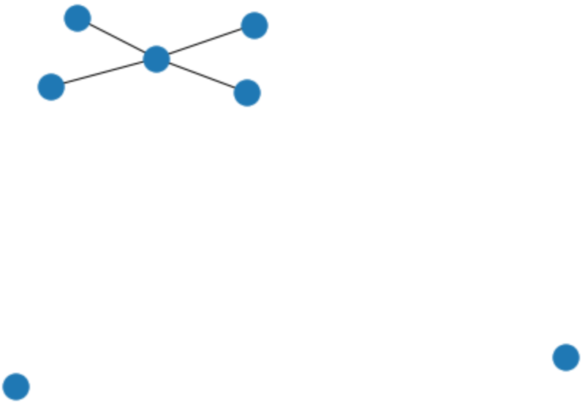
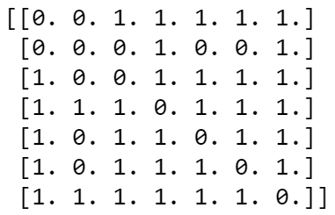
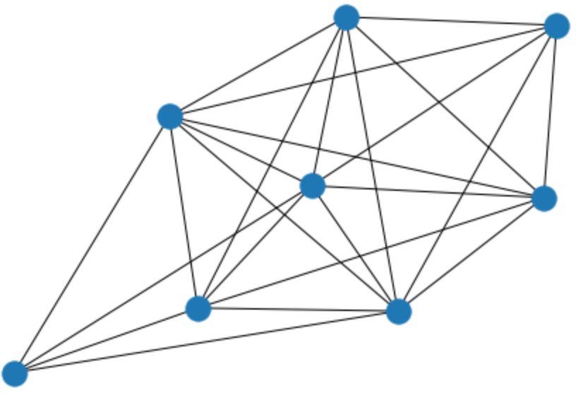
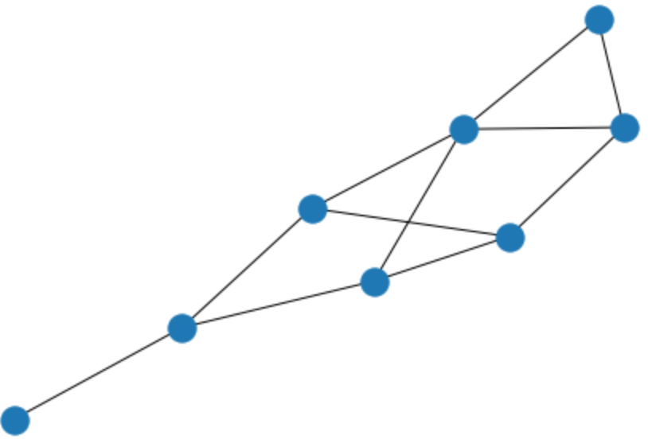
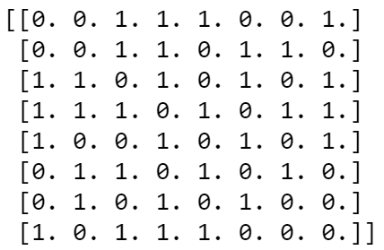
Training dataset
15,000 total graphs
original graph
partial graph + original degree info
allowed next edges
5 nodes
7 nodes
8 nodes

Slide 38
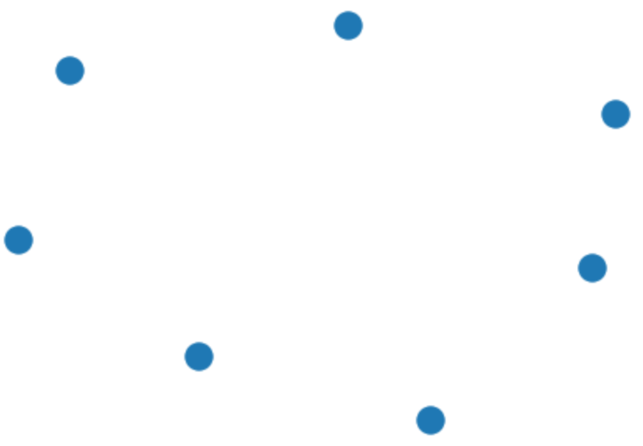
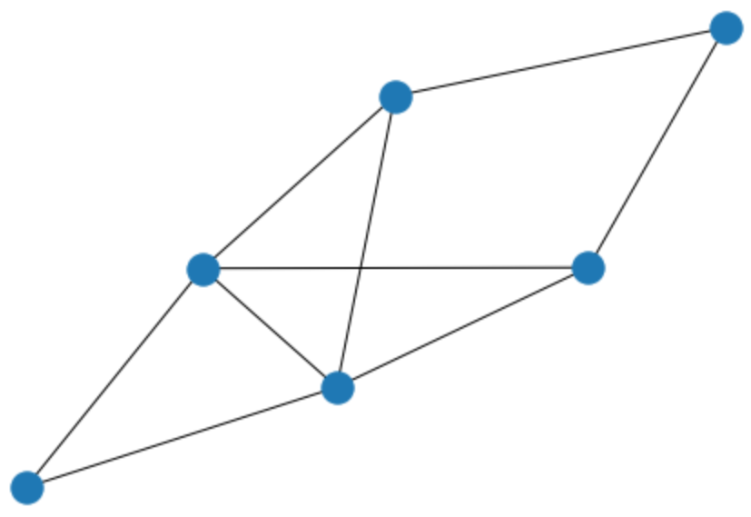
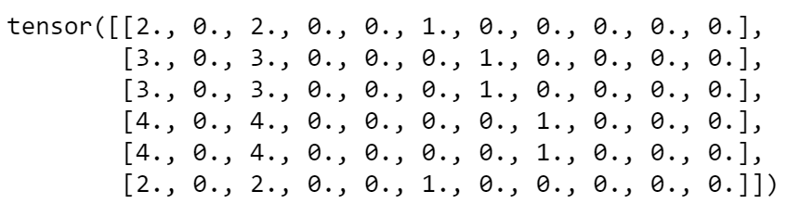
Evaluation dataset
1000 total graphs
original graph
start graph + original degree info
6 nodes
Original degree
Current degree
Remaining degree
Remaining degree one-hot encoded

Slide 39
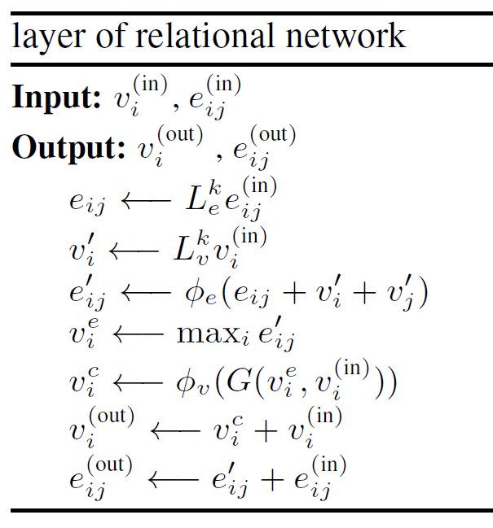
Model architecture
Key differences from original paper:
3 instead of 32 relational layers
Only 1 edge type (1024 → 1 instead of 4 in output layer)
Trained for only 2 epochs (approx. 2 hours on laptop)

Slide 40
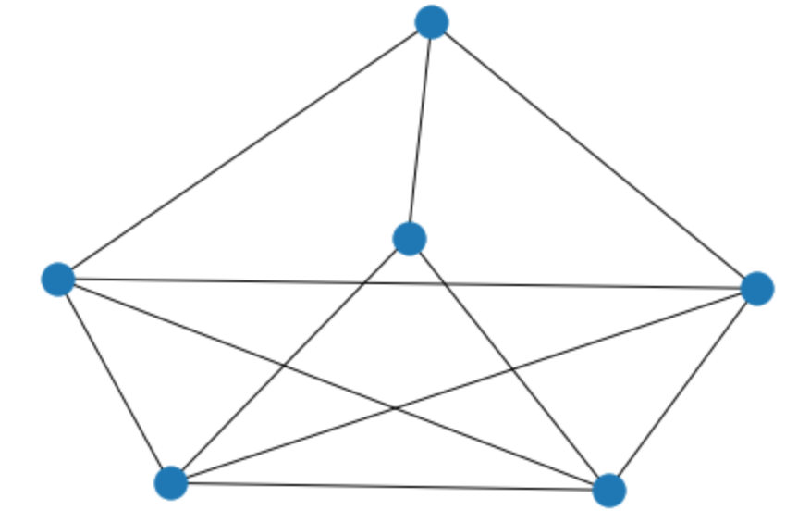
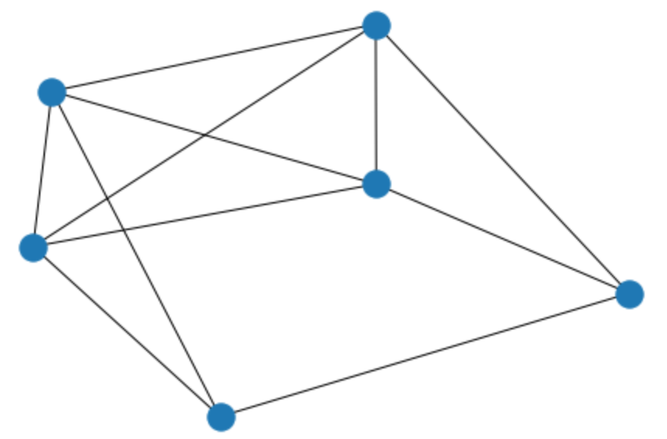















Results
true structure
candidate structures

Slide 41
Results
Argmax accuracy is 0.827
Sampling multiple candidate graphs randomly leads to accuracy of up to 1.0:
argmax accuracy
% samples for which at least 1 isomorphic graph is generated
# candidate graphs generated using inverse model

Slide 42
Results
Argmax accuracy is 0.524
Sampling multiple candidate graphs randomly leads to accuracy of up to 1.0:
argmax accuracy
% samples for which at least 1 isomorphic graph is generated
# candidate graphs generated using inverse model

Slide 43

Results
paper
implementation
999/1000 graphs have at least one correct structure
128 samples
50 samples

Slide 44
Results
% samples for which at least 1 isomorphic graph is generated
# candidate graphs generated using inverse model

Slide 45


Results
trained model
random graphs on 6 nodes
random connected graphs on 6 nodes
999/1000 graphs have at least one correct structure
44.3% graphs have at least one correct structure
47.9% graphs have at least one correct structure

